Slide 1


Phase Retrieval from the Short-Time Fourier Transform
Yonina Eldar
Technion – Israel Institute of Technology
Kishore Jaganathan and Babak Hassibi
Department of Electrical Engineering, Caltech
Optics Collaborators: Moti Segev and Oren Cohen

Slide 2
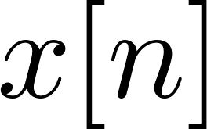
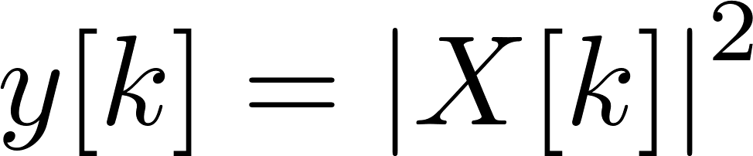
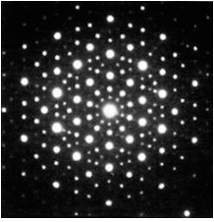
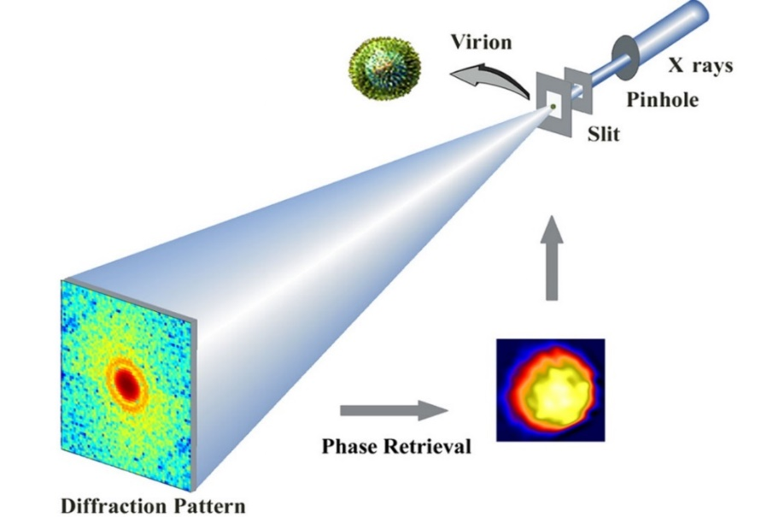
Phase Retrieval:
Recover a signal from its Fourier magnitude
Fourier +
Absolute value
Arises in many fields: crystallography (Patterson 35), astronomy (Fienup 82), optical imaging (Millane 90), and more
Given an optical image illuminated by coherent light, in the far field we obtain the image’s Fourier transform
Optical devices measure the photon flux,
which is proportional to the magnitude
Phase retrieval can allow direct recovery
of the image

Slide 3
Theory of Phase Retrieval
Difficult to analyze theoretically when recovery is possible
No uniqueness in 1D problems (Hofstetter 64)
Uniqueness in 2D if oversampled by factor 2 (Hayes 82)
No guarantee on stability
No known algorithms to achieve unique solution
Recovery from Fourier Measurements is Difficult!

Slide 4
Progress on Phase Retrieval
Assume random measurements to develop theory (Candes et. al, Rauhut et. al, Gross et. al, Li et. al, Eldar et. al, Netrapalli et. al, Fannjiang et. al …)
Introduce prior to stabilize solution
  Support restriction (Fienup 82)
  Sparsity (Moravec et. al 07, Eldar et. al 11, Vetterli et. al 11, Shechtman et. al 11)
Add redundancy to Fourier measurements
  Random masks (Candes et. al 13, Bandeira et. al 13)
  Short-time Fourier transform (Nawab et. al 83, Eldar et. al 15,
  Jaganathan et. al 15)
  Small number of fixed masks (Jaganathan et. al 15)
Today

Slide 5
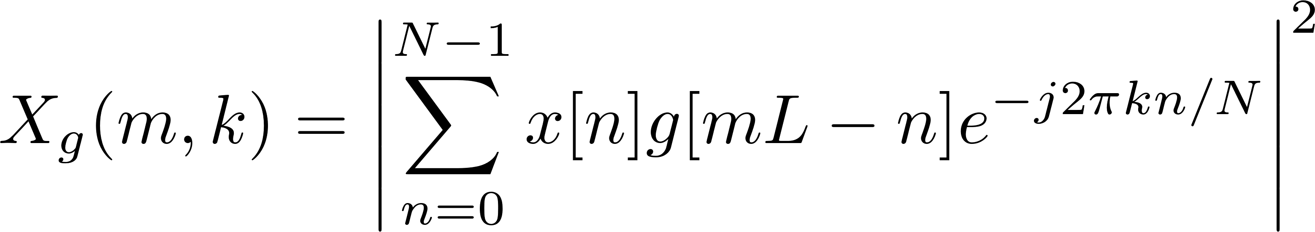
Recovery From the STFT Magnitude
L – step size
N – signal length
W – window length
Easy to implement in optical settings
  FROG – measurements of short pulses (Trebino and Kane 91)
  Ptychography – measurement of optical images (Hoppe 69)
Also encountered in speech/audio processing (Griffin and Lim 84, Nawab et. al 83)
Almost all signals can be recovered as long as there is overlap between the segments
Almost all signals can be recovered using semidefinite relaxation
Efficient algorithms like GESPAR work very well in practice

Slide 6
Talk Outline
Summary of phase retrieval results
Efficient algorithms
STFT in optics
Theoretical guarantees

Slide 7
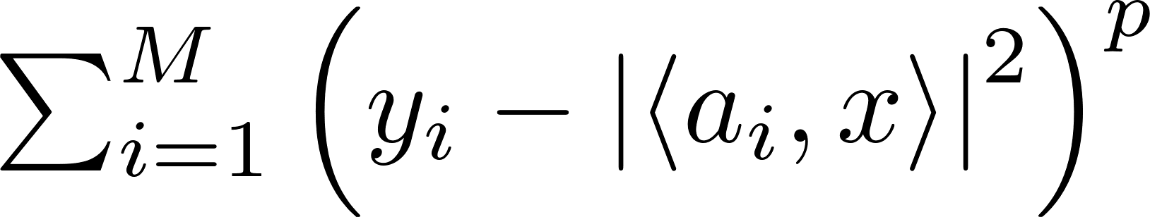
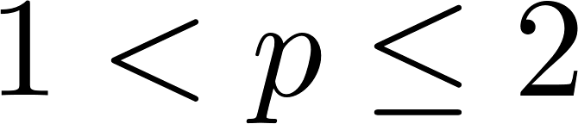
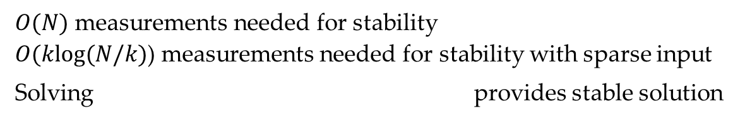
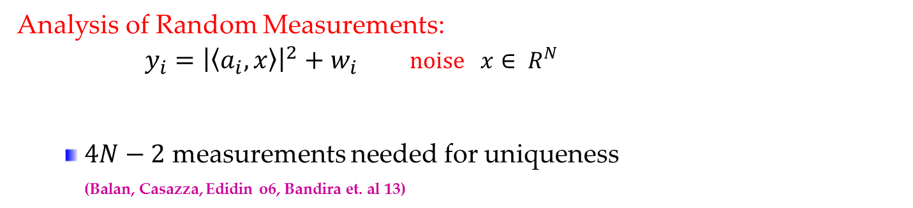
Analysis of Phase Retrieval
Analysis of Random Measurements:
$$y_{i}={\left|\left\langle a_{i},x\right\rangle \right|}^{2}+w_{i} noise x∈ R^{N}$$
  $4N−2$ measurements needed for uniqueness
  (Balan, Casazza, Edidin o6, Bandira et. al 13)
random vector
Stable Phase Retrieval (Eldar and Mendelson 14):
$O(N)$ measurements needed for stability
$O(klog(N/k)$) measurements needed for stability with sparse input
Solving provides stable solution
How to solve objective function?

Slide 8
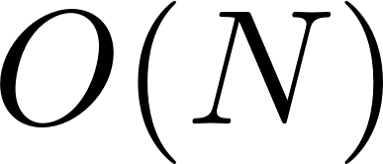
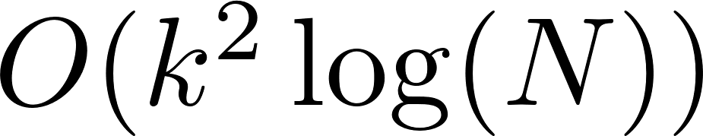
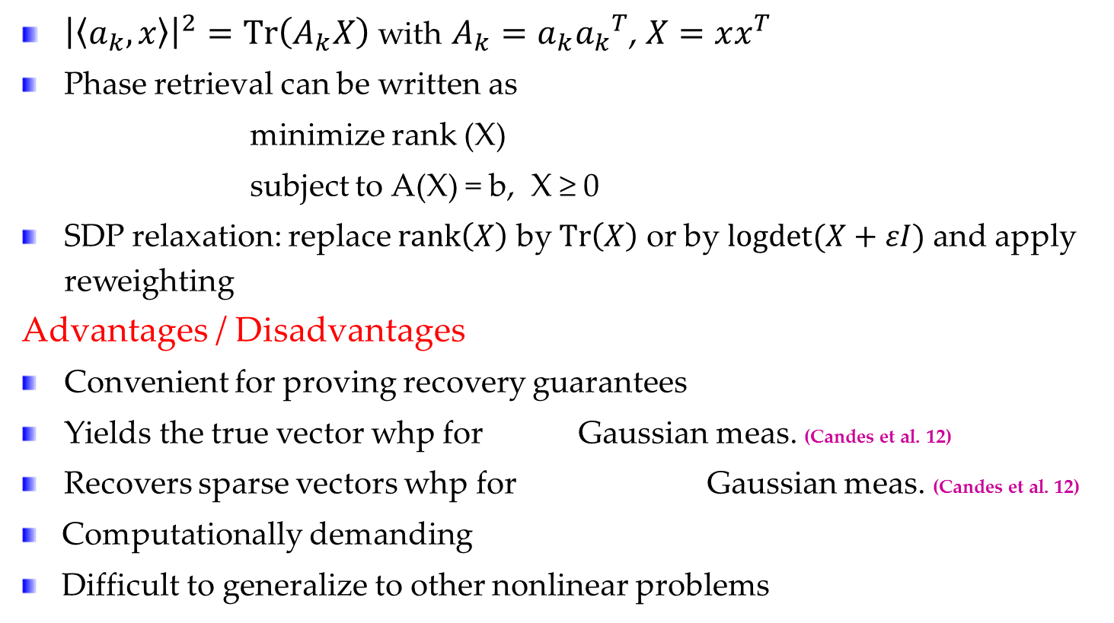
Recovery via Semidefinite Relaxation
Candes, Eldar, Strohmer ,Voroninski 12
${\left|\left\langle a_{k},x\right\rangle \right|}^{2}=Tr\left(A_{k}X\right)$ with $A_{k}=a_{k}{a_{k}}^{T}$, $X=xx^{T}$
Phase retrieval can be written as
minimize rank (X)
subject to A(X) = b, X ≥ 0
SDP relaxation: replace $rank\left(X\right)$ by $Tr\left(X\right)$ or by $logdet(X+εI)$ and apply reweighting
Advantages / Disadvantages
Convenient for proving recovery guarantees
Yields the true vector whp for Gaussian meas. (Candes et al. 12)
Recovers sparse vectors whp for Gaussian meas. (Candes et al. 12)
Computationally demanding
Difficult to generalize to other nonlinear problems

Slide 9

Efficient Algorithms
$\min{f\left(x\right)}$ s.t. ${\left\|x\right\|}_{0}≤k$
Beck and Eldar, 13
General theory and algorithms for nonlinear sparse recovery
Derive necessary conditions for optimal solution
Use them to generate algorithms
Necessary Conditions:
L-stationarity Iterative Hard Thresholding
CW-minima Greedy Sparse Simplex (OMP)
Greedy sparse simplex can be shown to be more powerful than IHT
Generalization of sparse recovery to the nonlinear setting!

Slide 10
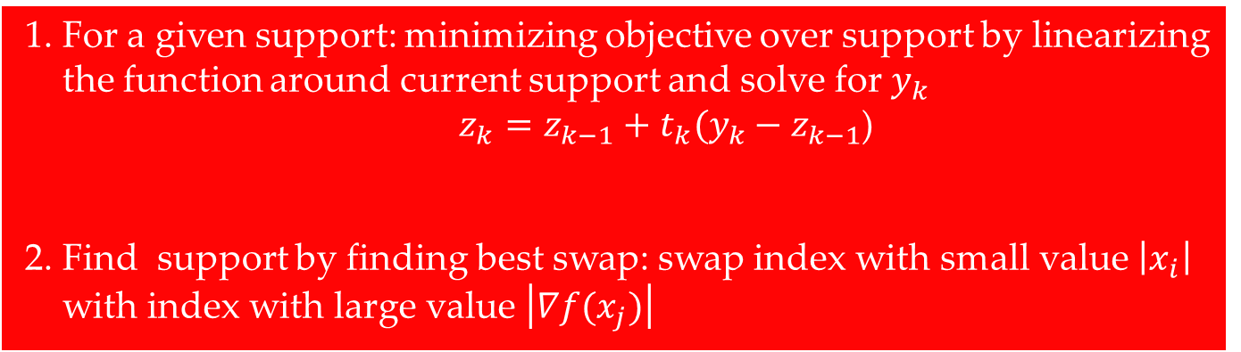
GESPAR:
GrEedy Sparse PhAse Retrieval
Shechtman, Beck and Eldar, 13
Generalization of matching pursuit to phase retrieval
Local search method with update of support
For given support solution found via Damped Gauss Newton
Efficient and more accurate than current techniques
1. For a given support: minimizing objective over support by linearizing
the function around current support and solve for $y_{k}$
    $z_{k}=z_{k−1}+t_{k}(y_{k}−z_{k−1}$)
2. Find support by finding best swap: swap index with small value $\left|x_{i}\right|$
with index with large value $\left|∇f(x_{j})\right|$
determined by backtracking

Slide 11
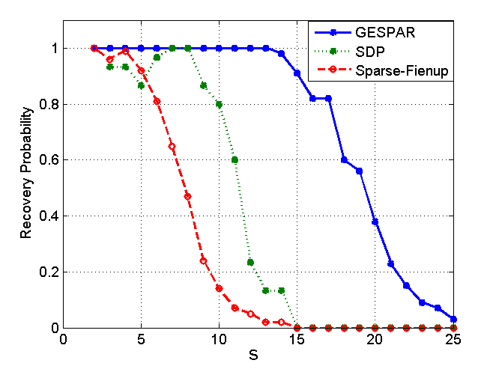
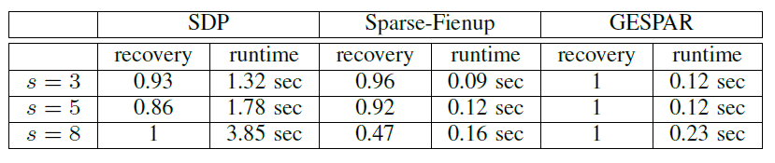
Performance Comparison
n=64
m=128
Each point = 100 signals

Slide 12

Provable Efficient Algorithms for Phase Retrieval
  Wirtinger flow (gradient algorithm with special initialization) achieves the bound $O(N)$ (Candes et. al 14,15)
  Wirtinger flow+thresholding requires $O(k^{2}log\left(N\right))$measurements (Li et. al 15)
  All recovery results for random measurements (or random masks)
Recent overview:
Y. Shechtman, Y. C. Eldar, O. Cohen,
H. N. Chapman, J. Miao, and M. Segev,
“Phase retrieval with application to optical imaging,”
SP magazine 2015
Moving to practice: Provable recovery from Fourier measurements?

Slide 13
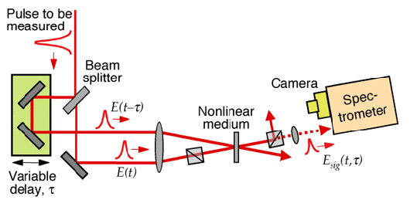
Frequency-Resolved Optical Gating (FROG)
Trebino and Kane 91
Method for measuring ultrashort laser pulses
The pulse gates itself in a nonlinear medium and is then spectrally resolved
In XFROG a reference pulse is used for gating
leading to STFT-magnitude measurements:
L – step size
N – signal length
W – window length

Slide 14
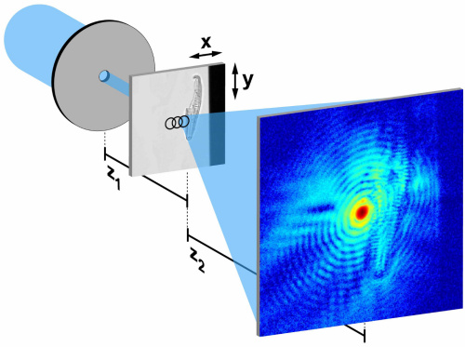
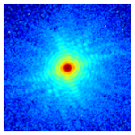

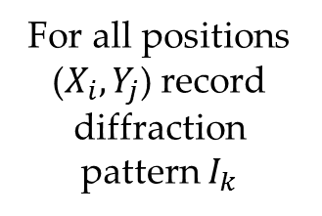



Ptychography
Hoppe 69
Plane wave
Scanning
For all positions ($X_{i}, Y_{j}$) record diffraction
pattern $I_{k}$
$$I_{K}$$
$$I_{3}$$
$$I_{2}$$
$$I_{1}$$
Method for optical imaging with X-rays
Records multiple diffraction patterns as a function of sample positions
Mathematically this is equivalent to recording the STFT

Slide 15
Current and New Results
Existing results:
Fienup-type algorithms – iterate between constraints in time and constraints in frequency
    Griffin-Lim (Griffin and Lim 84)
    XFROG (Kane 08)
No general conditions for unique solution
No general proofs of recovery
Our contribution:
Uniqueness results from STFT measurements
Guaranteed recovery using semidefinite relaxation
Efficient algorithm: Adaption of GESPAR
Extension of results to masked measurements

Slide 16
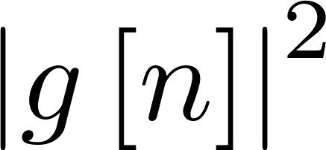
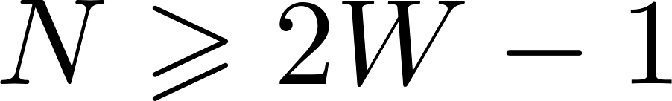
Theoretical Guarantees
Uniqueness condition for L=1 and all signals:
Theorem (Eldar, Sidorenko, Mixon et. al 15)
The STFT magnitude with L=1 uniquely determines any x[n] that is everywhere
nonzero (up to a global phase factor) if:
The length-N DTFT of is nonzero
N and W-1 are coprime
Uniqueness condition for general overlap and almost all signals:
Theorem (Jaganathan, Eldar and Hassibi 15)
The STFT magnitude uniquely determines almost any x[n] that is everywhere
nonzero (up to a global phase factor) if:
The window g[n] is nonzero
2.
Strong uniqueness for 1D signals and Fourier measurements (without sparsity)

Slide 17
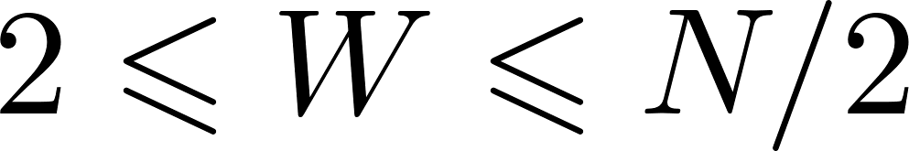
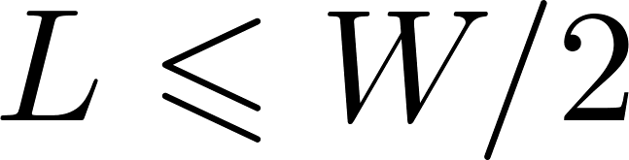
Recovery From STFT via SDP
Theorem (Jaganathan, Eldar and Hassibi 15)
SDP relaxation uniquely recovers any x[n] that is everywhere nonzero from the
STFT magnitude with L=1 (up to a global phase factor) if
In practice SDP relaxation seems to work as
long as (at least 50% overlap)
Strong phase transition at L=W/2
Probability of Success for N=32 for different
L and W
Can prove the result assuming the first W/2 values of x[n] are known
L=W/2
L
W

Slide 18
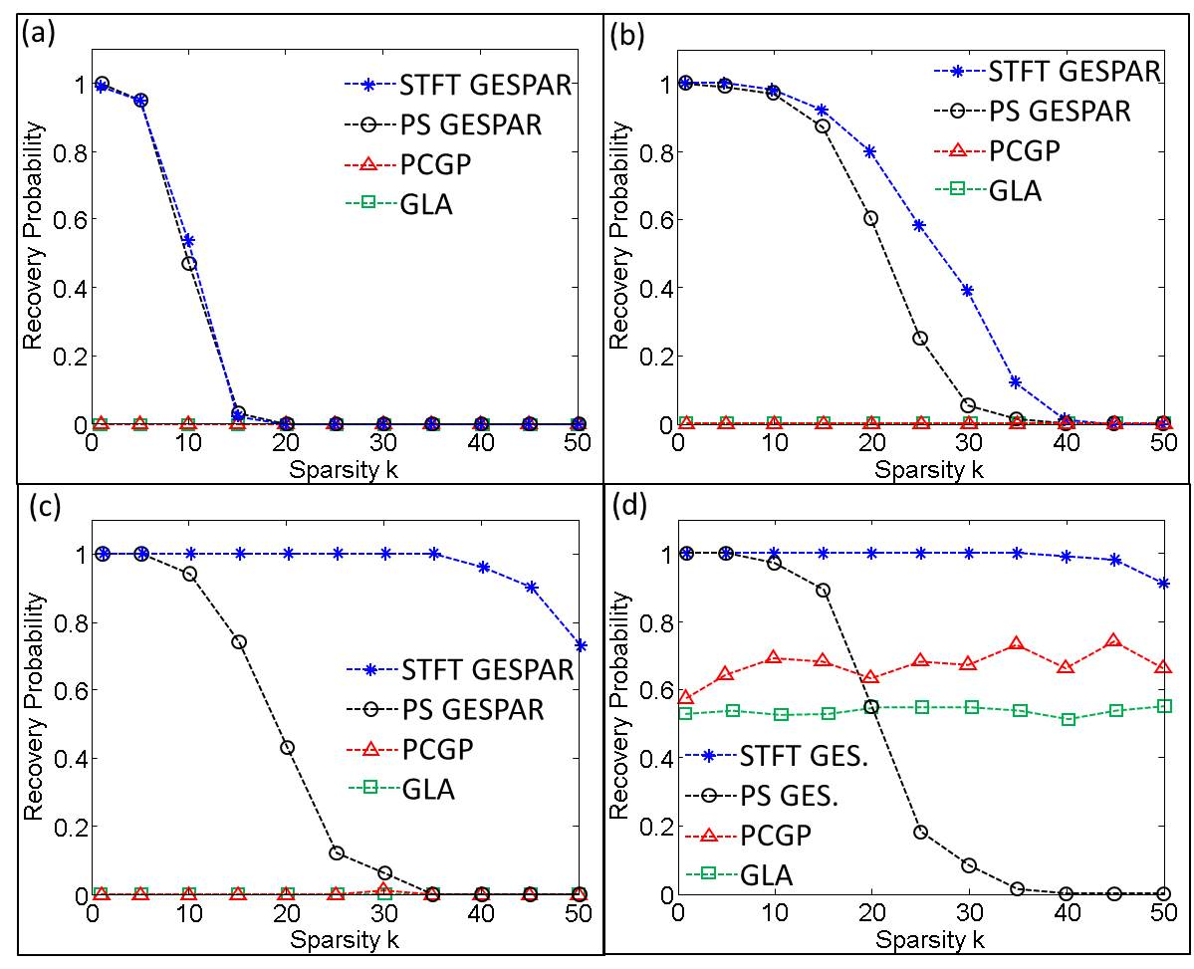
GESPAR for STFT Recovery
Eldar, Sidorenko et. al 15
W=16, N=64 varying L
L=2,4,8,16 (no overlap)
PS GESPAR uses oversampled FT with the same number of measurements as STFT

Slide 19
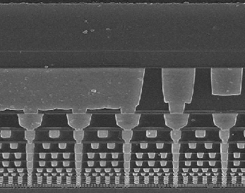
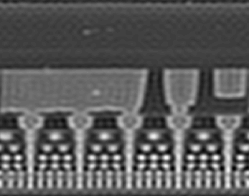
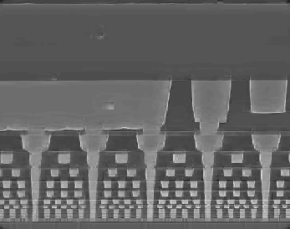
Recovery from Lowpass Data
Original
Blurred
Sidorenko et al
Reconstruction
Line out
Orig.
Rec.
Blurr.

Slide 20
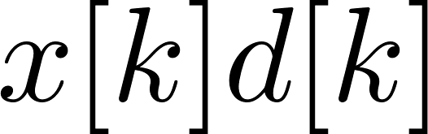
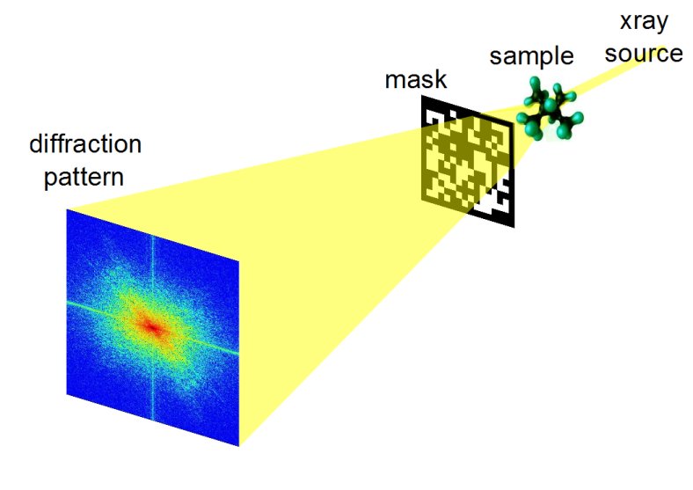
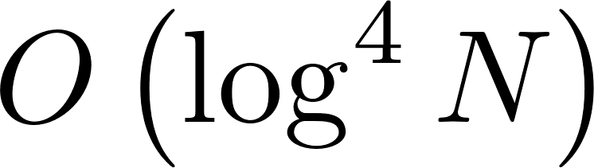
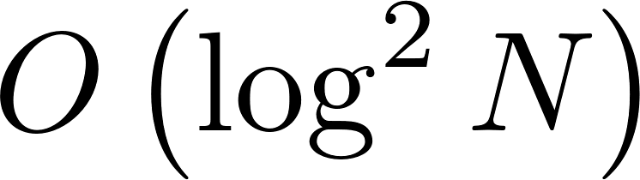
Coded Diffraction Patterns
Candes, Li and Soltanolkotabi 13
Modulate the signals with masks before measuring
Assume an admissible mask d[k] for which
Using masks the signal can be recovered
Gross et. al improved to
Difficulty: random masks, large constants

Slide 21
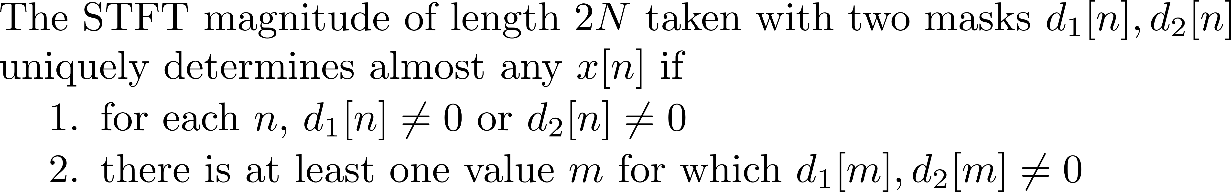
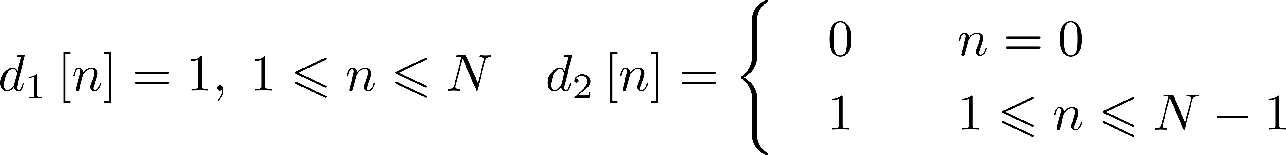
Efficient Masks
2 deterministic masks each with 2N measurements suffice!
To recover all signals x[n] we can use specific masks which also guarantee stable recovery via SDP
Theorem (Jaganathan, Eldar and Hassibi 15)

Slide 22
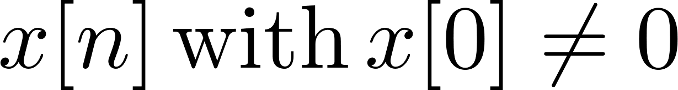
Efficient Masks
Theorem (Jaganathan, Eldar and Hassibi 15)
Any can be recovered in a robust fashion from the two
previous masks using a semidefinite relaxation
Idea can be extended to allow for 5 masks, and each one measured with only N measurements

Slide 23
Conclusion
STFT provides an effective way to measure in the Fourier domain
Provides better recovery for the same number of measurements
Provable recovery guarantees
Efficient methods in practice
Deterministic robust masks can be constructed that are very efficient
Future work: complete SDP relaxation analysis
Practical Method for Fourier Phase Retrieval

Slide 24
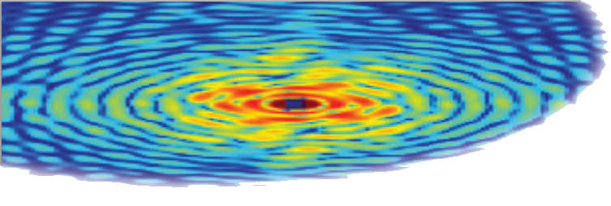
Thank you!

